Slide 1

Introduction to AI Intelligent Agents SY B.Sc. (CS)
Semester VI
Poornima .N
Assistant Professor, Department of IT/CS
1

Slide 2

2 Topics:
Introduction of agents
Structure of Intelligent agent
Characteristics of Intelligent agents
Do you know how machines take smart decisions just
like humans? Let’s see
how!

Slide 3

3 What is an Agent?
An agent is anything that perceives its environment and acts upon it.
Example:
Human → Eyes & ears (perceive), Hands & legs (act).
Robot vacuum → Sensors (perceive), Motors (act). Formula: 👉 Agent = Sensors + Actuators + Intelligence

Slide 4
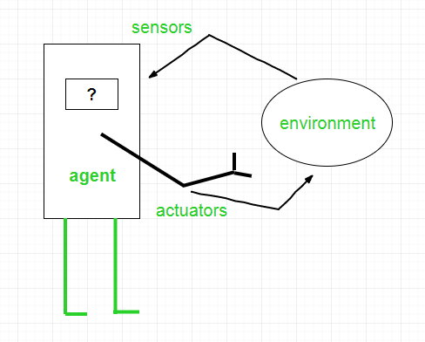

Slide 5
4 Activity 1
List 3 agents you use daily and what they sense + what they do.
“Perceive → Act”

Slide 6
5 Environment of an Agent
The environment is everything outside the agent that it interacts with.
Example:
Robot vacuum → your home.
Self-driving car → road, traffic, weather.
The agent function maps what it perceives to what it does.

Slide 7
6 Activity 2
Think of a student as an agent. What’s your environment in college?

Slide 8
7 Structure of an Intelligent Agent
The structure of an intelligent agent defines how an agent is built internally to perceive, decide, and act intelligently.

Slide 9
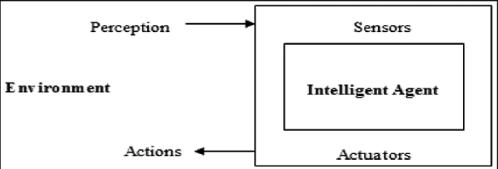

Slide 10
8 Activity 3
Imagine you’re building a ‘smart dustbin’ that opens automatically.
– What would be its sensors? – What would be its actuators? – What would be its agent program’s job?

Slide 11
9 PEAS Representation
How do we describe an agent’s job?
PEAS = Performance, Environment, Actuators, Sensors
Example: Self-driving car
P: Safety, time, comfort
E: Roads, traffic
A: Steering, brakes
S: Cameras, GPS

Slide 12
10 Activity 3
Design a PEAS for a Smart Fridge

Slide 13
11 Characteristics of Intelligent Agents
Reactivity: Responds to changes in the environment.
Pro-activeness: Takes initiative to reach goals.
Social Ability: Interacts with other agents or humans.
Autonomy: Works independently without continuous help.
Adaptability: Learns and improves with time.
Goal Orientation: Acts purposefully to achieve a goal.

Slide 14
Next Class Preview
12
Types of Agents
“When a game enemy chases you perfectly, is it just lucky… or a different type of agent?”

Slide 15

Thank you…

